Slide 1

AI and Machine Learning for Edge Devices
John Edwards

Slide 2
Survey Scope
Survey
Model Development
Frameworks
Background
Resource Management
Hardware
Compression Methods
Pre-Runtime
Runtime
Inference
Training
Empirical Energy Analysis
Edge Devices
Cloud Computing Challenges
On-device Models
Data Gathering and Preprocessing
Edge Applications
Notes:
Scope is fairly large
For time I will cover the circled items in this presentation
Worth mentioning: MicroTVM in frameworks, various resource management algorithms
Did not cover edge applications in great detail

Slide 3

Background on Edge Computing

Slide 4
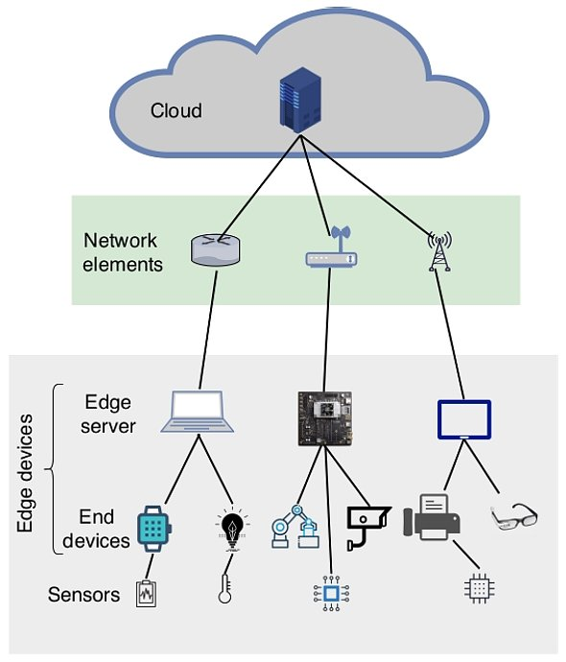
Edge Devices
A broad category of computing devices located at the periphery of a network
Generally closest to data collection/generation points
e.g. edge servers, personal computers, IoT devices, mobile devices
Klingler, viso.ai, accessed April 2025

Slide 5
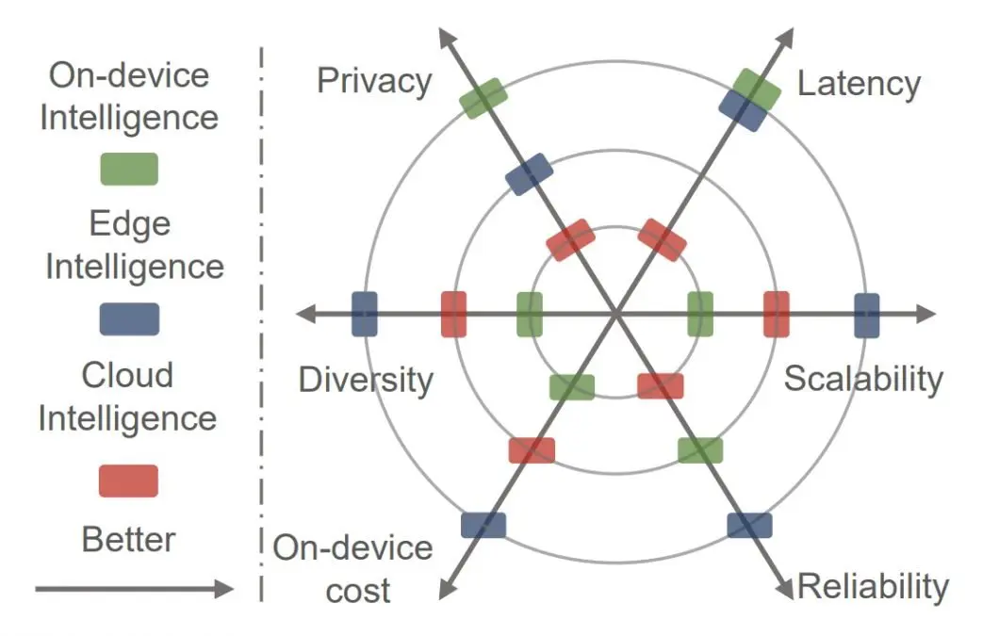
Tradeoffs in Machine Learning
On-device Model Advantages
Data privacy
Reduced latency
Energy efficiency
Server Model Advantages
Scalability
Reliability
Accuracy
Maintenance
Klingler, viso.ai, accessed April 2025

Slide 6
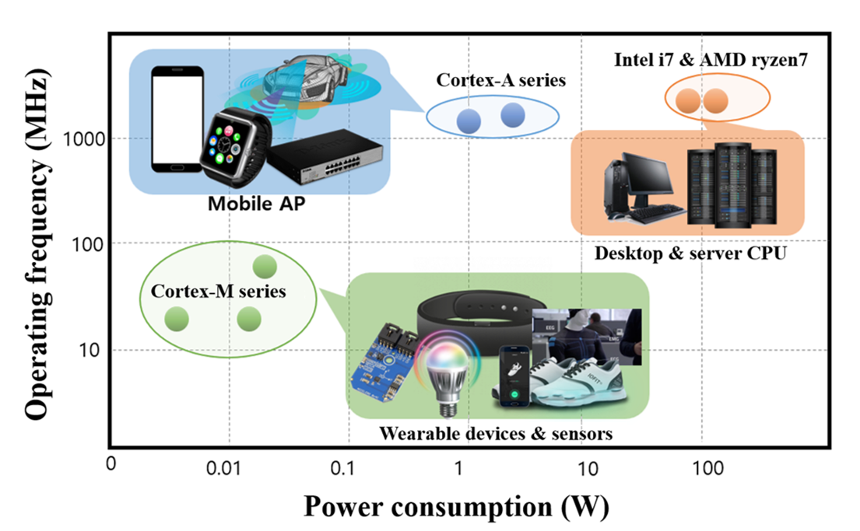
Implementation Challenges
Edge devices offer fewer resources compared to cloud servers
Smaller memory
Reduced processing power
Power constraints (especially when battery-powered)
Distributed Training and Inference
Data privacy concerns
Communication overhead
Network bandwidth
Server computing bandwidth
Minkwan, Kee et al. 2022

Slide 7

Runtime Optimization

Slide 8
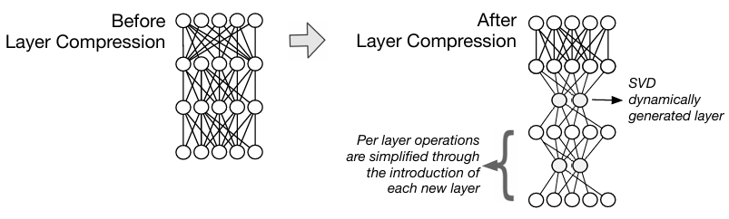
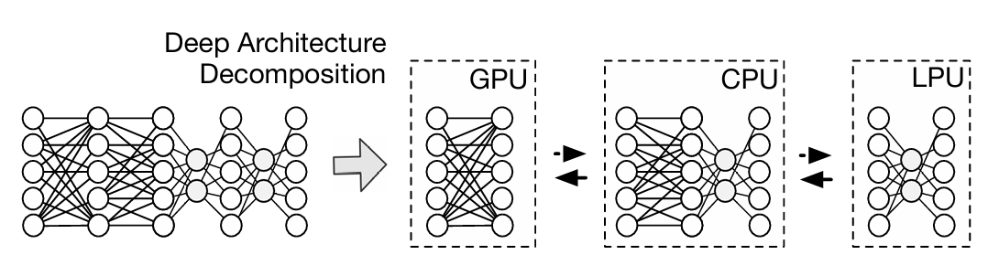
DeepX: A Software Accelerator for Low-Power Deep Learning Inference on Mobile Devices by Lane et al.
DeepX – a two-stage approach
Runtime Layer Compression (RLC)
Dimensionality reduction using singular value decomposition (SVD)
An error estimation used to rank compressed layer configurations
No retraining
Deep Architecture Decomposition (DAD)
Decomposition search
Recomposition Inference
N. D. Lane et al., 2016

Slide 9
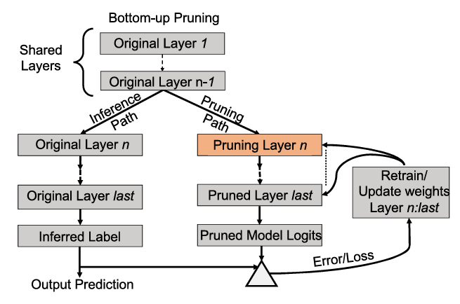
Hardware-friendly User-specific Machine Learning for Edge Devices by Goyal et al.
MyML adapts general ML models to user preferences
Tracks frequently used categories/classes
Saves early layers
Prunes classification layers
Periodically starts from scratch when user preferences change
Goyal,Vidushi et al. 2022

Slide 10

Studies on Power Consumption

Slide 11
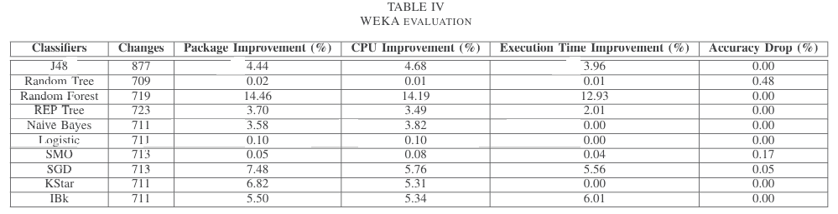
Energy-Efficient Machine Learning on the Edges by Kumar et al.
JEPO – a Java code analyzer for energy efficiency
int is most energy efficient primitive
if-then-else better than ternary operator
modulus most expensive arithmetic operator
Kumar, Mohit et al. 2020

Slide 12
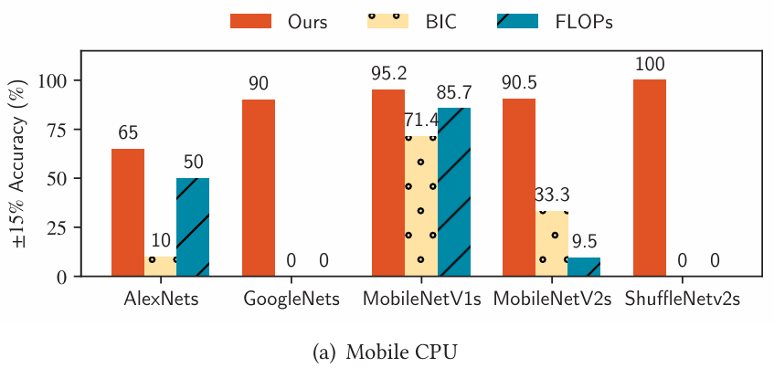
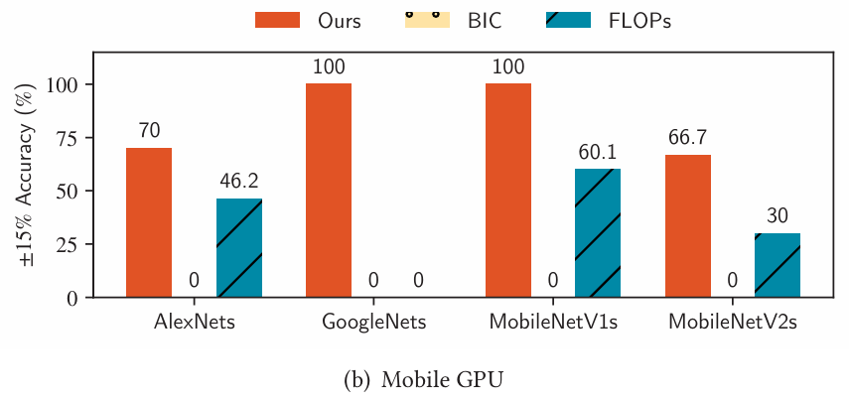
Unveiling Energy Efficiency in Deep Learning: Measurement, Prediction, and Scoring across Edge Devices by Tu et al.
Accurately measure kernel level operations for energy prediction model
Outperformed FLOPs-based and BIC-based predictors
Novel scoring metrics:
Power consumption score (PCS)
Inference energy consumption score (IECS)
Tu, Xiaolong et al 2023

Slide 13
References
N. Klingler, "viso.ai," [Online]. Available: https://viso.ai/edge-ai/edge-devices/. [Accessed April 2025].
Minkwan Kee and Gi-Ho Park. 2022. A Low-power Programmable Machine Learning Hardware Accelerator Design for Intelligent Edge Devices. ACM Trans. Des. Autom. Electron. Syst. 27, 5, Article 51 (September 2022), 13 pages.
N. D. Lane et al., "DeepX: A Software Accelerator for Low-Power Deep Learning Inference on Mobile Devices," 2016 15th ACM/IEEE International Conference on Information Processing in Sensor Networks (IPSN), Vienna, Austria, 2016, pp. 1-12, doi: 10.1109/IPSN.2016.7460664.
Vidushi Goyal, Reetuparna Das, and Valeria Bertacco. 2022. Hardware-friendly User-specific Machine Learning for Edge Devices. ACM Trans. Embed. Comput. Syst. 21, 5, Article 62 (September 2022), 29 pages.
M. Kumar, X. Zhang, L. Liu, Y. Wang and W. Shi, "Energy-Efficient Machine Learning on the Edges," 2020 IEEE International Parallel and Distributed Processing Symposium Workshops (IPDPSW), New Orleans, LA, USA, 2020, pp. 912-921, doi: 10.1109/IPDPSW50202.2020.00153.
Fanariotis, A.; Orphanoudakis, T.; Kotrotsios, K.; Fotopoulos, V.; Keramidas, G.; Karkazis, P. Power Efficient Machine Learning Models Deployment on Edge IoT Devices. Sensors 2023, 23, 1595.
Xiaolong Tu, Anik Mallik, Dawei Chen, Kyungtae Han, Onur Altintas, Haoxin Wang, and Jiang Xie. 2024. Unveiling Energy Efficiency in Deep Learning: Measurement, Prediction, and Scoring across Edge Devices. In Proceedings of the Eighth ACM/IEEE Symposium on Edge Computing (SEC '23). Association for Computing Machinery, New York, NY, USA, 80–93.

